Slide 1
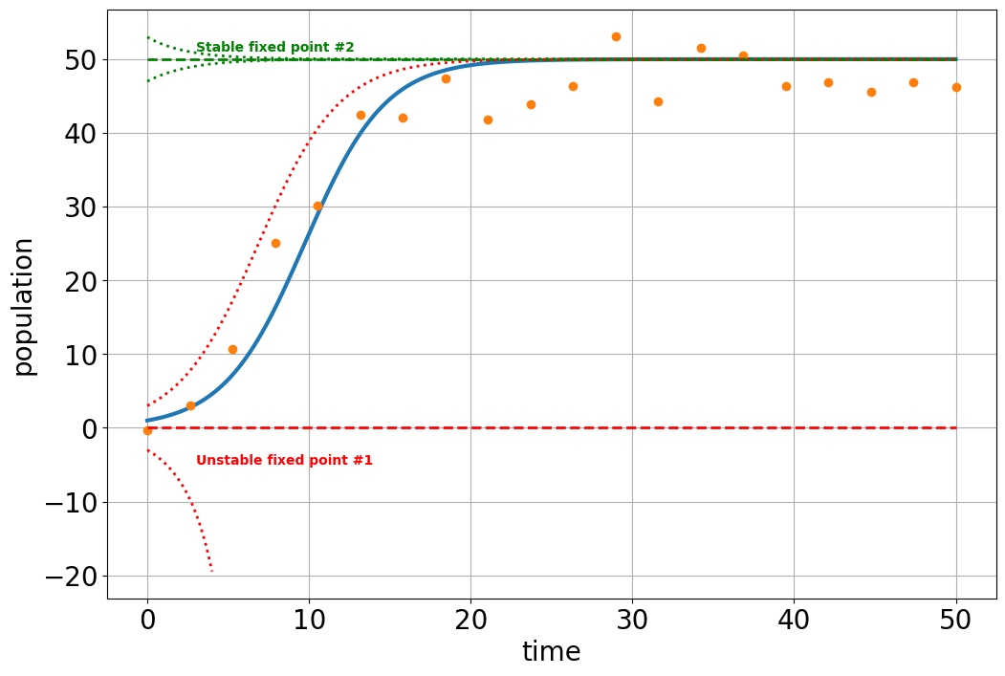





Original system
$$y=K$$
$$y′=ry\left(1−\frac{y}{K}\right)$$
Fixed Points
0$=ry\left(1−\frac{y}{K}\right)$
$$y=0, y=K$$
$$y=0$$

Slide 2













$$u^{′}=α−u+u^{2}v$$
$$v^{′}=β−u^{2}v$$
$$\#1: 0=α−u+u^{2}v$$
Solve for the variables in terms of the parameters
#2: 0$=β−u^{2}v$
$$\#2: u^{2}v=β$$
$$\#1: 0=α−u+β$$
$$u=$$
$$\#1: u=α+β$$
$$v=$$
$$\#2:{(α+β)}^{2}v=β$$
$$\#1: u=α+β$$
$$\#2:v=β/{(α+β)}^{2}$$
$$\#2:v=β/{(α+β)}^{2}$$

